Slide 1
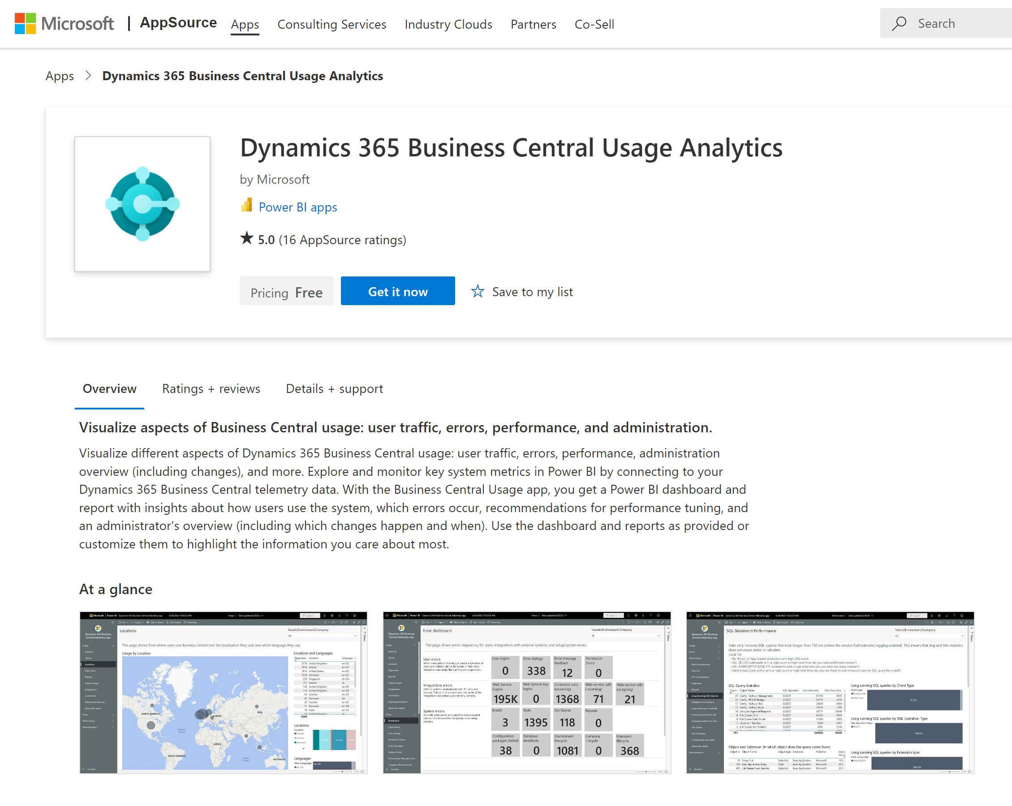
Get the app from aka.ms/bctelemetryreport

Slide 2
Excel layouts in five bullets
Interactive reports (Not designed for print, One report can serve multiple purposes (filtering, sorting, slicers, pivot tables etc.)
Mix’n’match data from Business Central with other data sources (Sharepoint lists, On-premises databases, files, APIs, …) using Power Query in the report.
Use built-in, advanced Excel features to do post-processing on rendered reports (triggering automation flows, Organization data types, What-if analyses, Forecast sheet, Analyze Data with support for natural language)
Rich collaboration capabilities (commenting, sharing, protecting for certain audiences) on a report
Democratized design experience - allowing end users to participate more actively in layout creation. Contains the raw data, making it possible for a user to understand how the report works

Slide 3
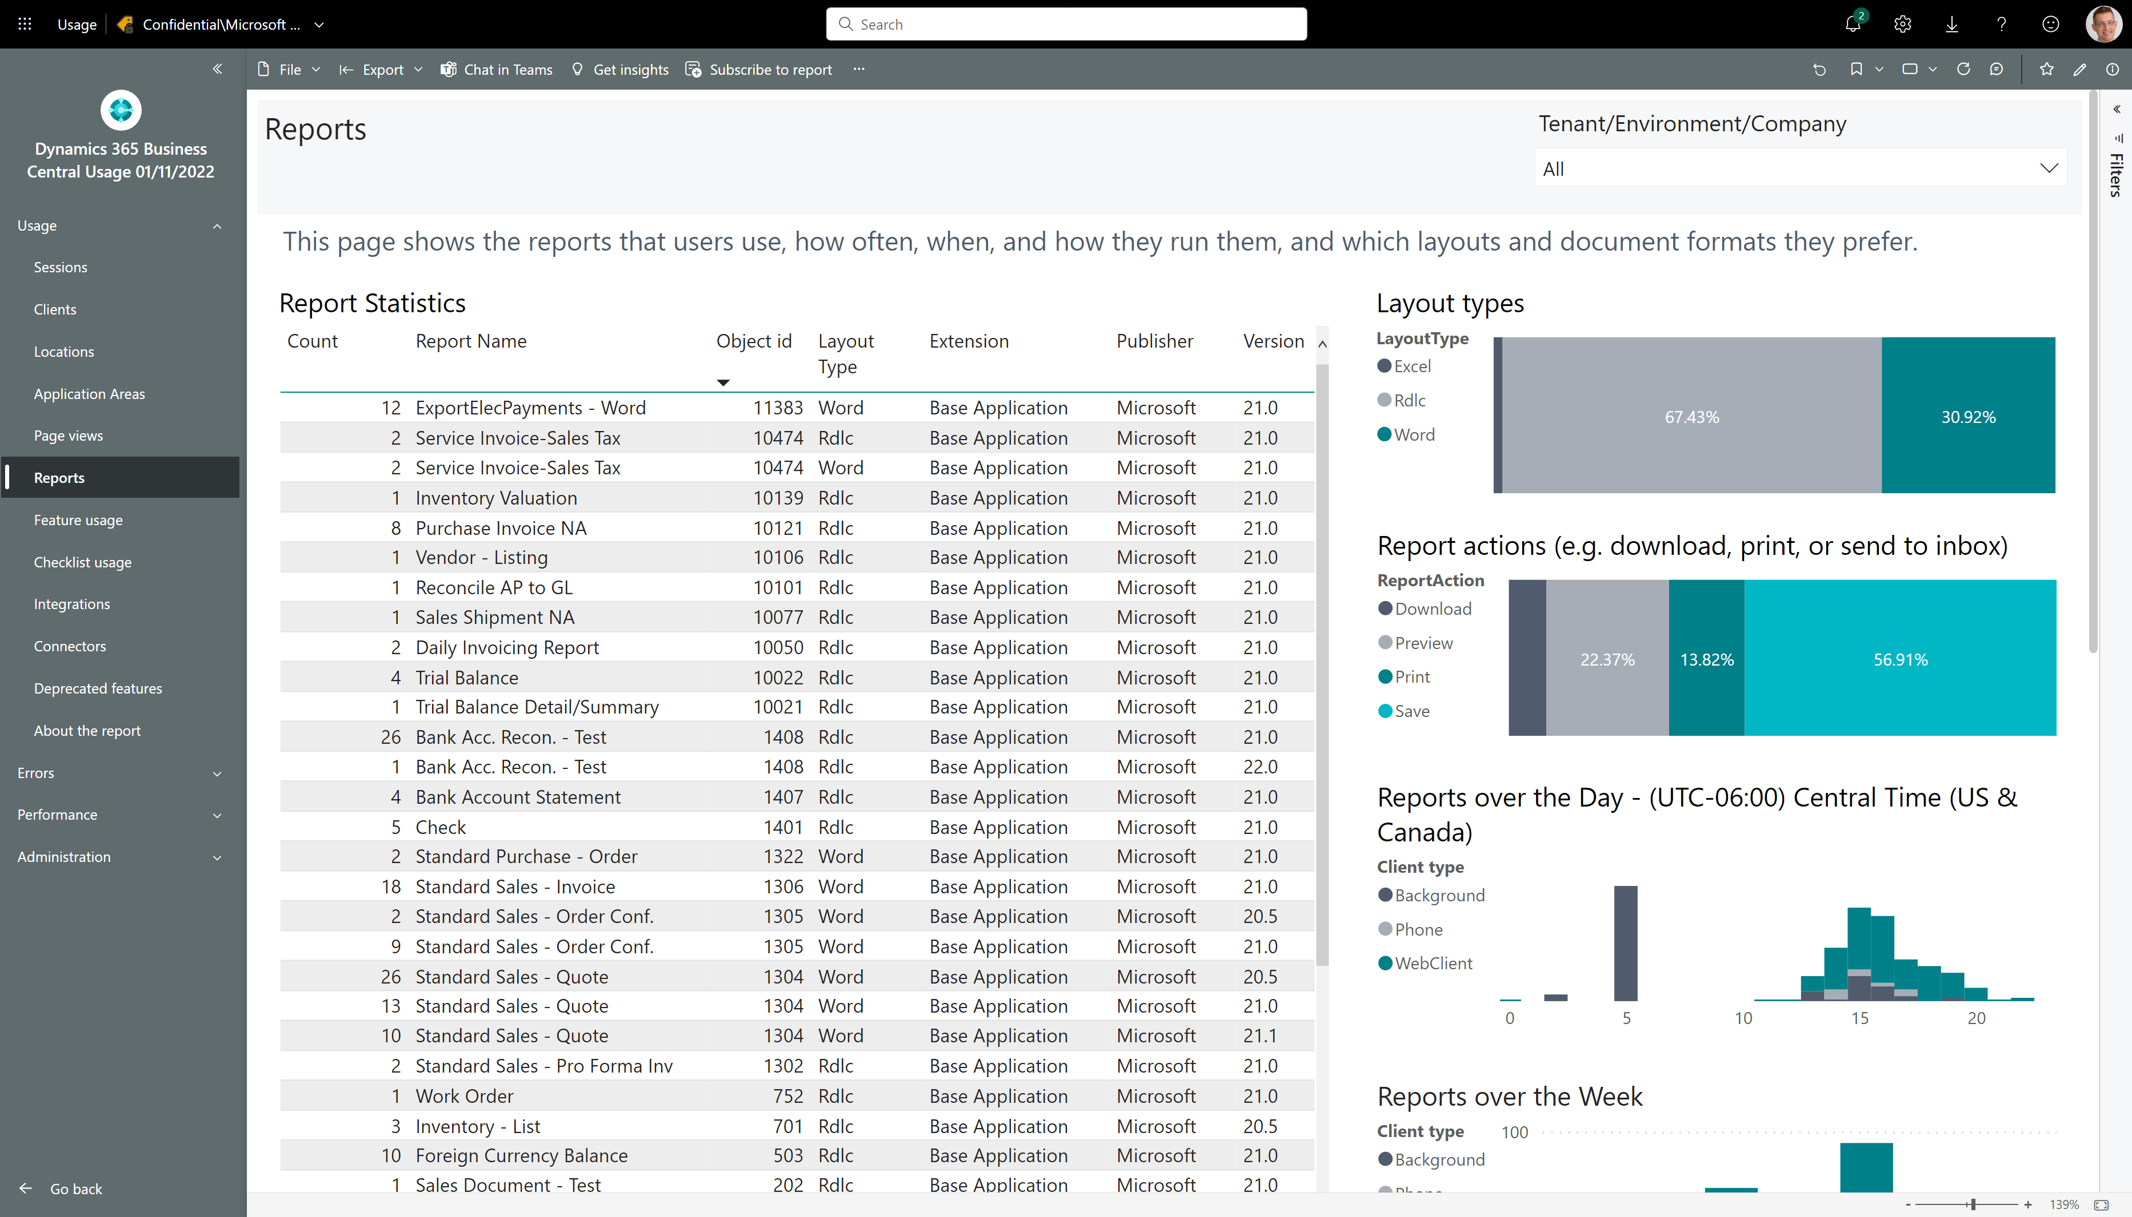
How to see if customer is using Excel layouts

Slide 4
End users can make report layouts with Excel
Excel layouts usage?
No Excel layouts usage?
Maybe collaborate closer on reporting?
You as partner can focus on AL report objects and customer can focus on layout
Introduce Power Query in Excel
Maybe PoC reports that mix data from Business Central with other data sources (Using Power Query)
Showcase sample layouts from https://aka.ms/bcexcelsamples
Maybe do a presentation on Excel layouts. Sample presentation is available from https://aka.ms/bcexcelsamples

Slide 5
Excel layouts resources
Samples
https://aka.ms/bcexcelsamples
Documentation
Working with Excel Layouts - Business Central | Microsoft Learn
Videos
https://github.com/microsoft/BCTech/blob/master/samples/Excel/VIDEOS.md

